Slide 1
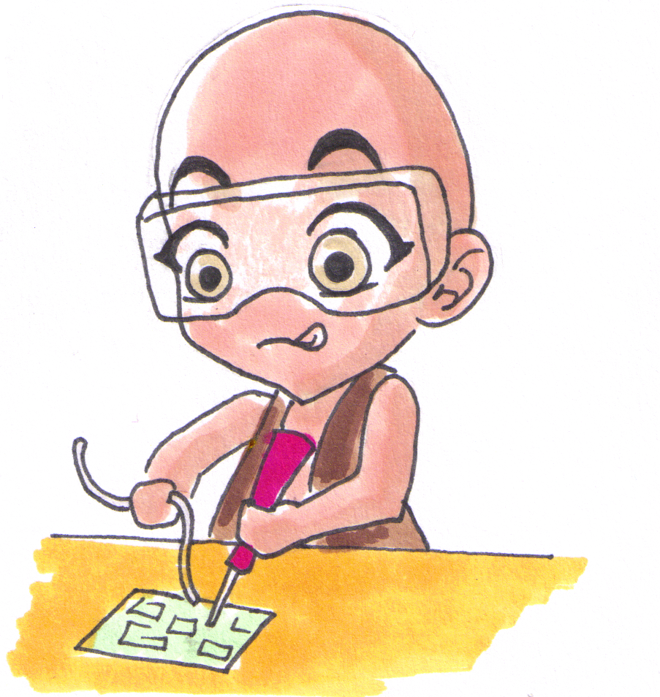
Learn to Solder
Dallas Makerspace
28 December 2018
Dale Wheat

Slide 2
Introduction
Goal Introduction to soldering for electronic projects
Time One hour
Format Hands-on
Instructor Dale Wheat
Requirements Desire to learn

Slide 3
Goals and Expectations
Just enough practice to get started
Learn to use the basic tools safely
Inspire new ideas
Your goals?

Slide 4
Safety Concerns
Burn hazard
Soldering irons are hot enough to melt metal
Causes the kind of pain that lasts for days
Lead is a poison
We will be using solder that contains lead
Lead-free solder is available but is more difficult to use
Wash your hands after handling solder containing lead
Small parts are used
Wear your good reading glasses, if needed
Always have good lighting
Eye protection is available

Slide 5
Preflight Check
Comfy?
Nervous?
Work area clear?
Tools in reach?
Adequate lighting?
Sponge wet?
Power on!

Slide 6
Part 1 – Wood Burning
Hold the soldering iron like a pencil in your dominant hand
Never touch the metal parts of the soldering iron
Locate your block of wood
Hold the wood with your non-dominant hand
Use the soldering iron to “draw” on the wood
Show off your (choose one):
Artistic capabilities
Hand lettering
Spelling
Melt some solder

Slide 7
Part 2 – Practice Makes Perfect
Fill some of the holes with solder
Install the components
Solder the components
Trim the leads
Repeat

Slide 8
Part 3 – Build the Wee Blinky
Overview
Identify the components
Install shortest components first
Observe component polarity
Test

Slide 9
1 Page
4 Steps

Slide 10
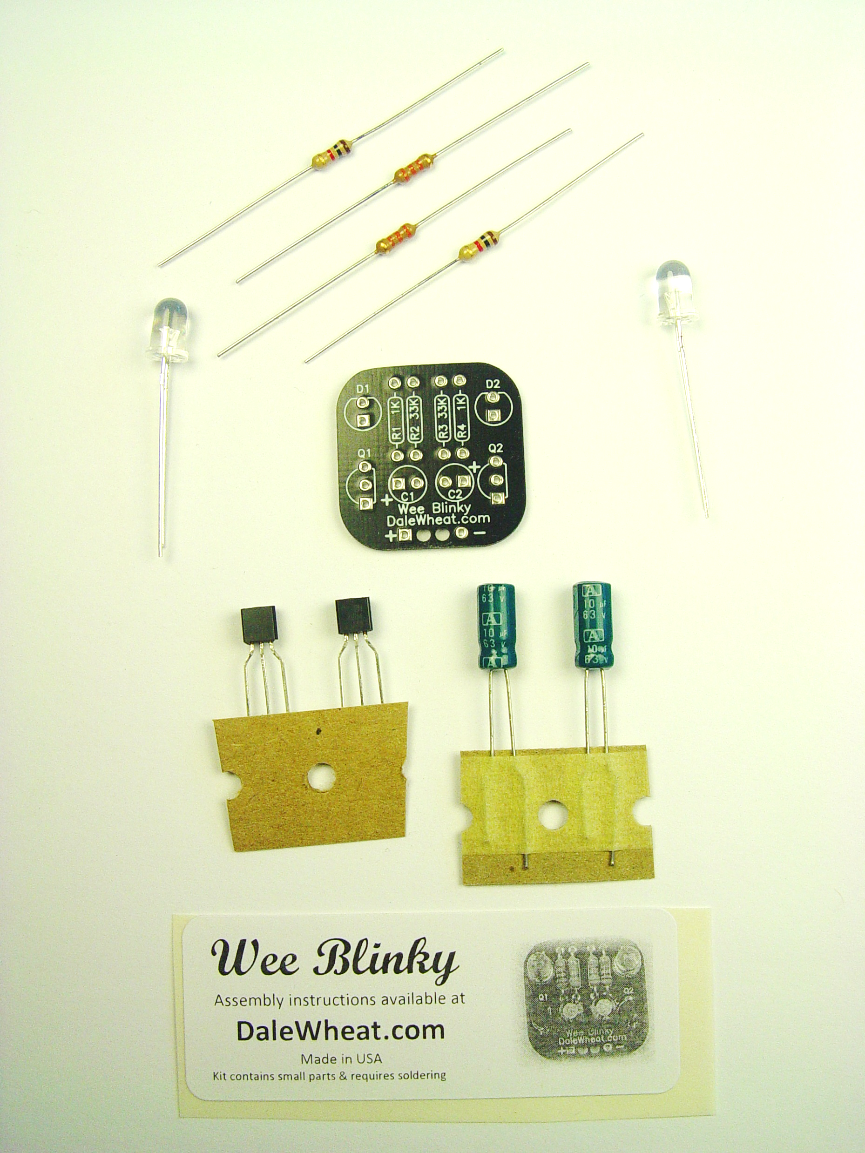
Parts Check
(1) Wee Blinky PCB
(2) 1KΩ resistor – brown, black, red stripes
(2) 33KΩ resistor – orange, orange, orange stripes
(2) LEDs
(2) Transistors
(2) Capacitors
(1) 9V battery snap (not pictured)

Slide 11
Install Resistors
Resistors are NOT polarized
They can be installed in any direction
Install all four resistors at once…
R1 = 1KΩ
R2 = 33KΩ
R3 = 33KΩ
R4 = 1KΩ
… or install one at a time

Slide 12
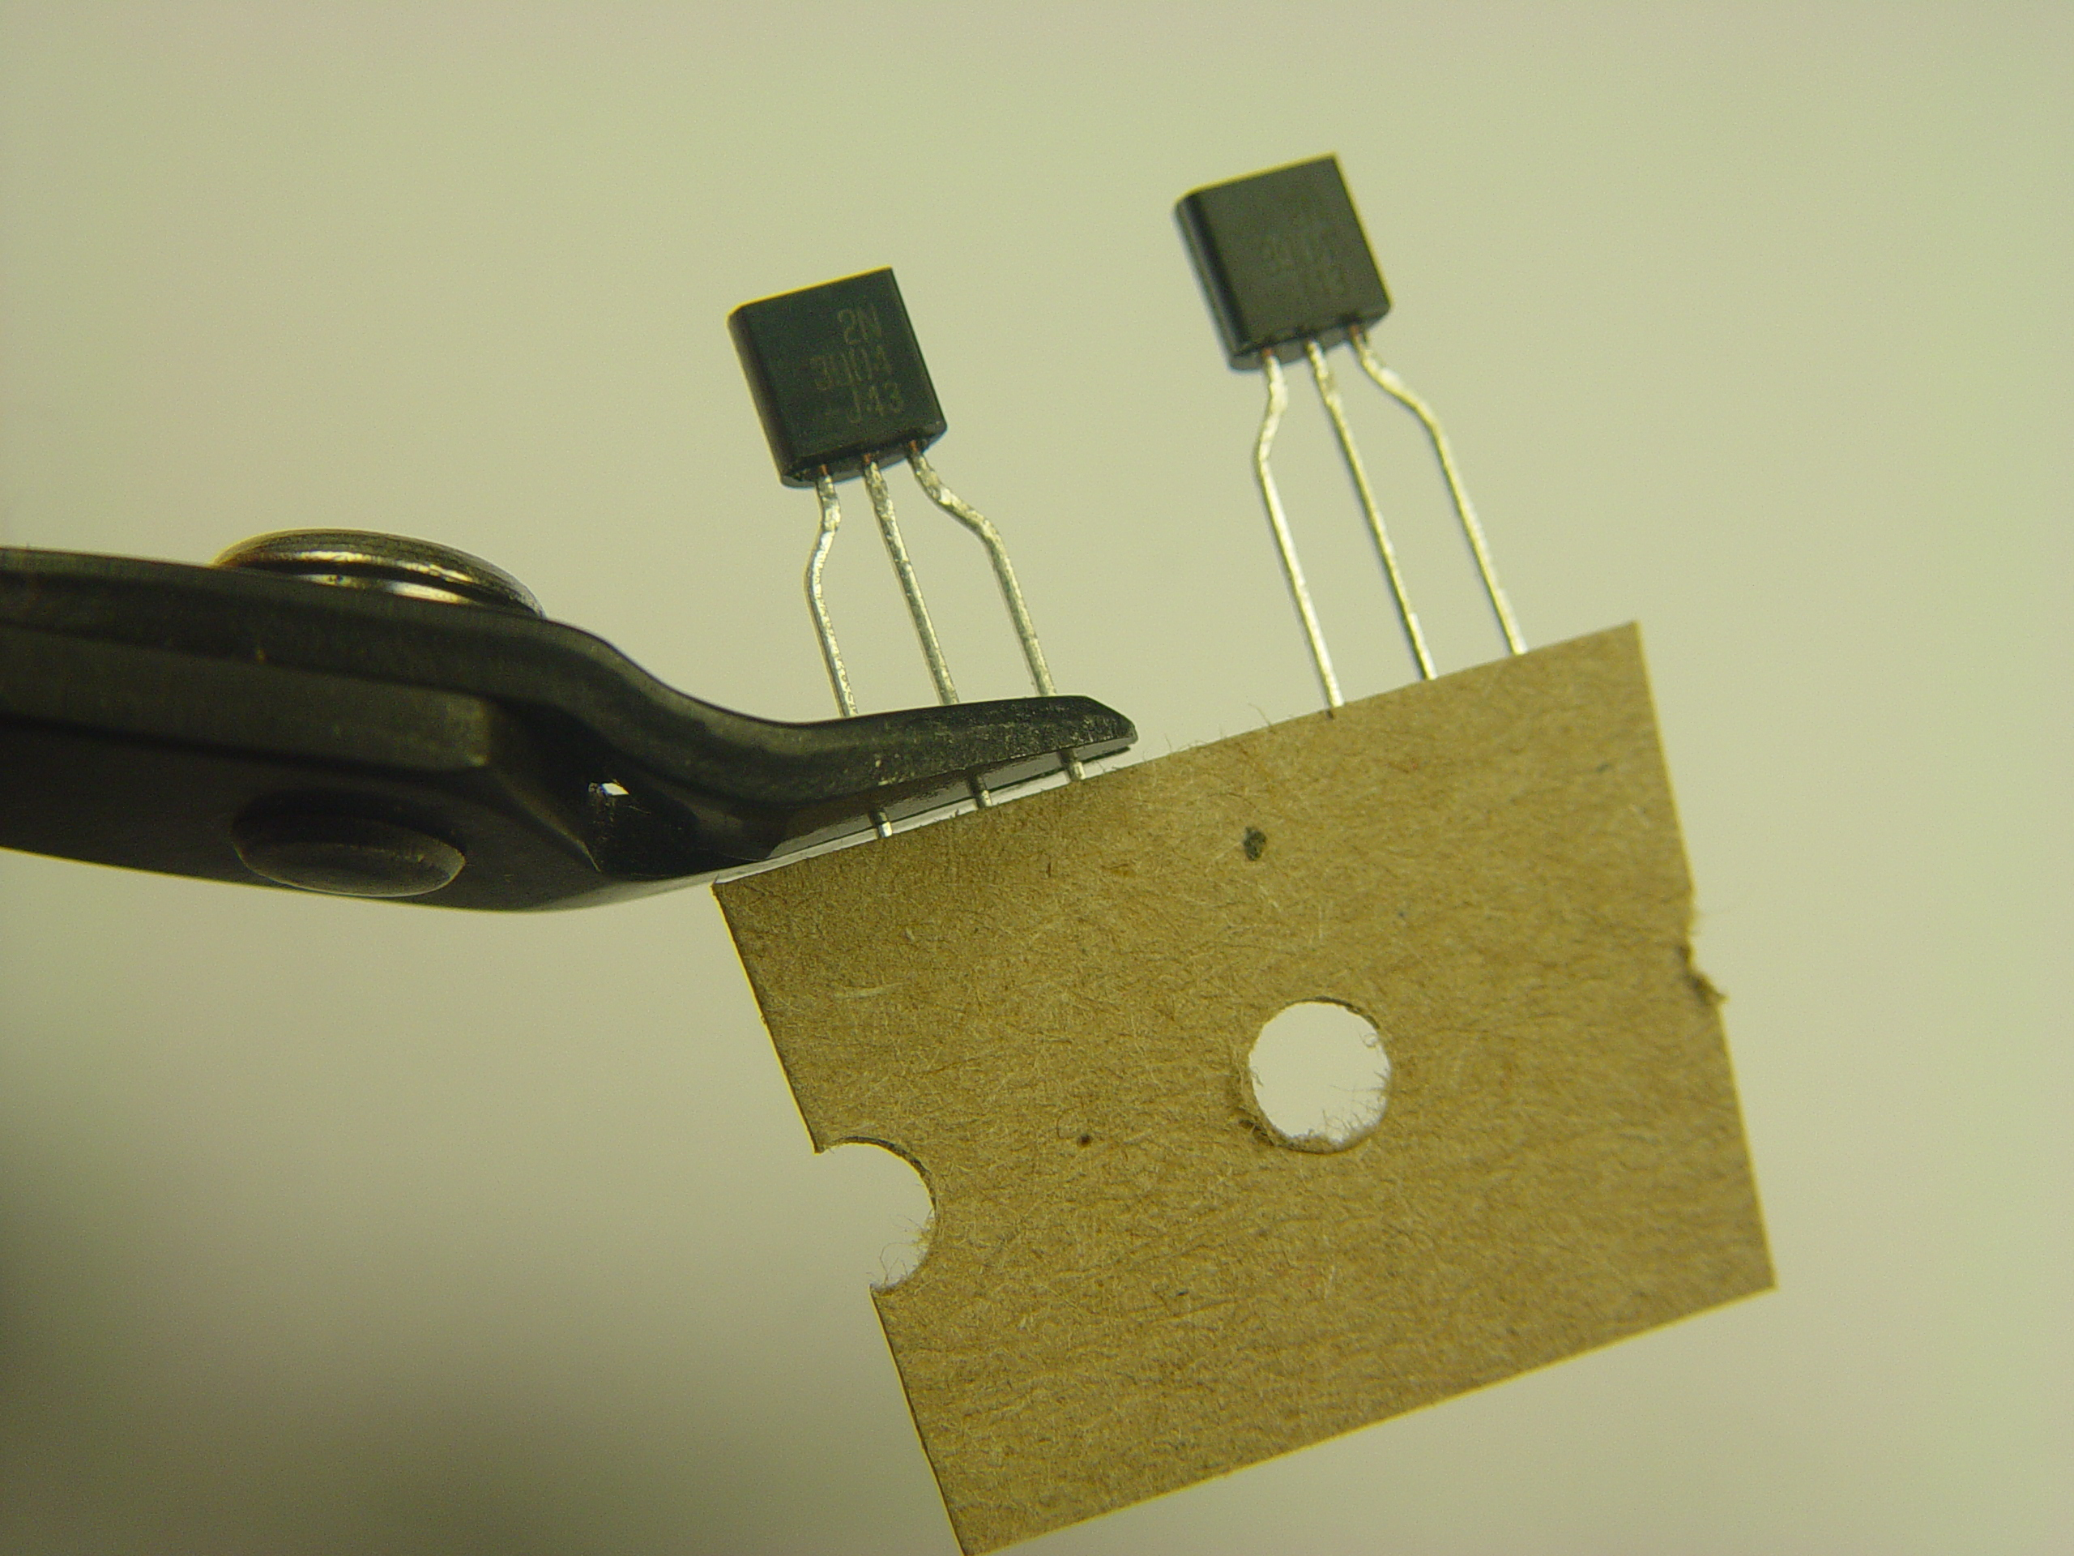
Install Transistors
Cut leads as long as possible
Transistors ARE polarized
Both transistors face the same direction
Refer to part outlines on PCB

Slide 13
Install LEDs
LEDs ARE polarized
“Long lead, square hole!”
Various possible mountings:
Flush
Weird

Slide 14
Install Capacitors
Capacitors ARE polarized
“Long lead, square hole!”
Stripes face each other

Slide 15
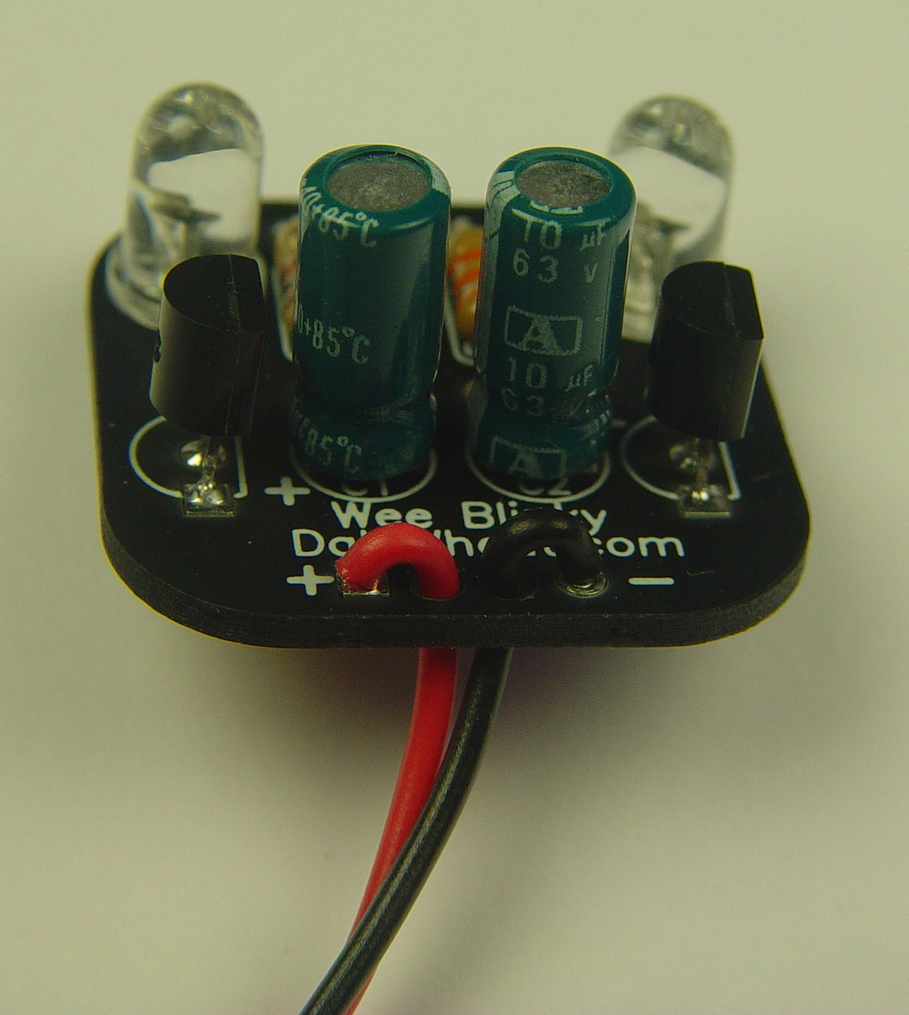
Attach Battery Snap
Red wire is [+]
Black wire is [‒]
Lace through center holes
Just do one at a time

Slide 16
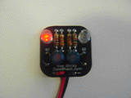
Time to Test!
Double check your soldering
Double check component placement
Double check component orientation
Ready?
Test it!

Slide 17
Do Not Do It Like This

Slide 18
Review
What did you learn?
Do you like soldering?
How to improve this class
Contact Dale Wheat
dale@dalewheat.com
https://www.dalewheat.com
“dalewheat” on DMS Talk

Slide 19
Thank You!

