Slide 1

Basic Electronic Applications
Fun with 555s
Dale Wheat
February 2019
Dallas Makerspace

Slide 2
Course outline
The basics of electricity
Simple components and how to identify them
How to read a schematic
Building circuits on solderless breadboards
Trouble-shooting techniques

Slide 3
The Basics of Electricity
Electricity likes to flow in a circle, i.e., a circuit
  Electrons flow from negative to positive – this is known as “electron current”
  We usually think of electricity as flowing from positive to negative – “conventional current”
Electricity flowing in one direction at a constant rate is called “direct current”, or DC.
  This is what comes out of a battery, for example.
Electricity that reverses direction is called “alternating current”, or AC.
  AC travels better over long distances. This is what comes out of the wall sockets.

Slide 4
Simple components & how to identify them
Conductors
Resistors
Capacitors
LEDs
Integrated circuits
Switches

Slide 5
Conductors
Conductors are devices that allow the free flow of electrical current
Wires, cables and connectors are examples of conductors
Most conductors are metals, such as copper, silver or aluminum
All conductors have some amount of resistance to the flow of electrical current
Typical wires have a center conductor covered by a non-conducting insulator
Wire sizes in North America use the American Wire Gauge (AWG)
We will be using 24 gauge wire in this class
  The diameter of the conductor is 0.02”
  The typical resistance is 0.025 ohms per foot

Slide 6
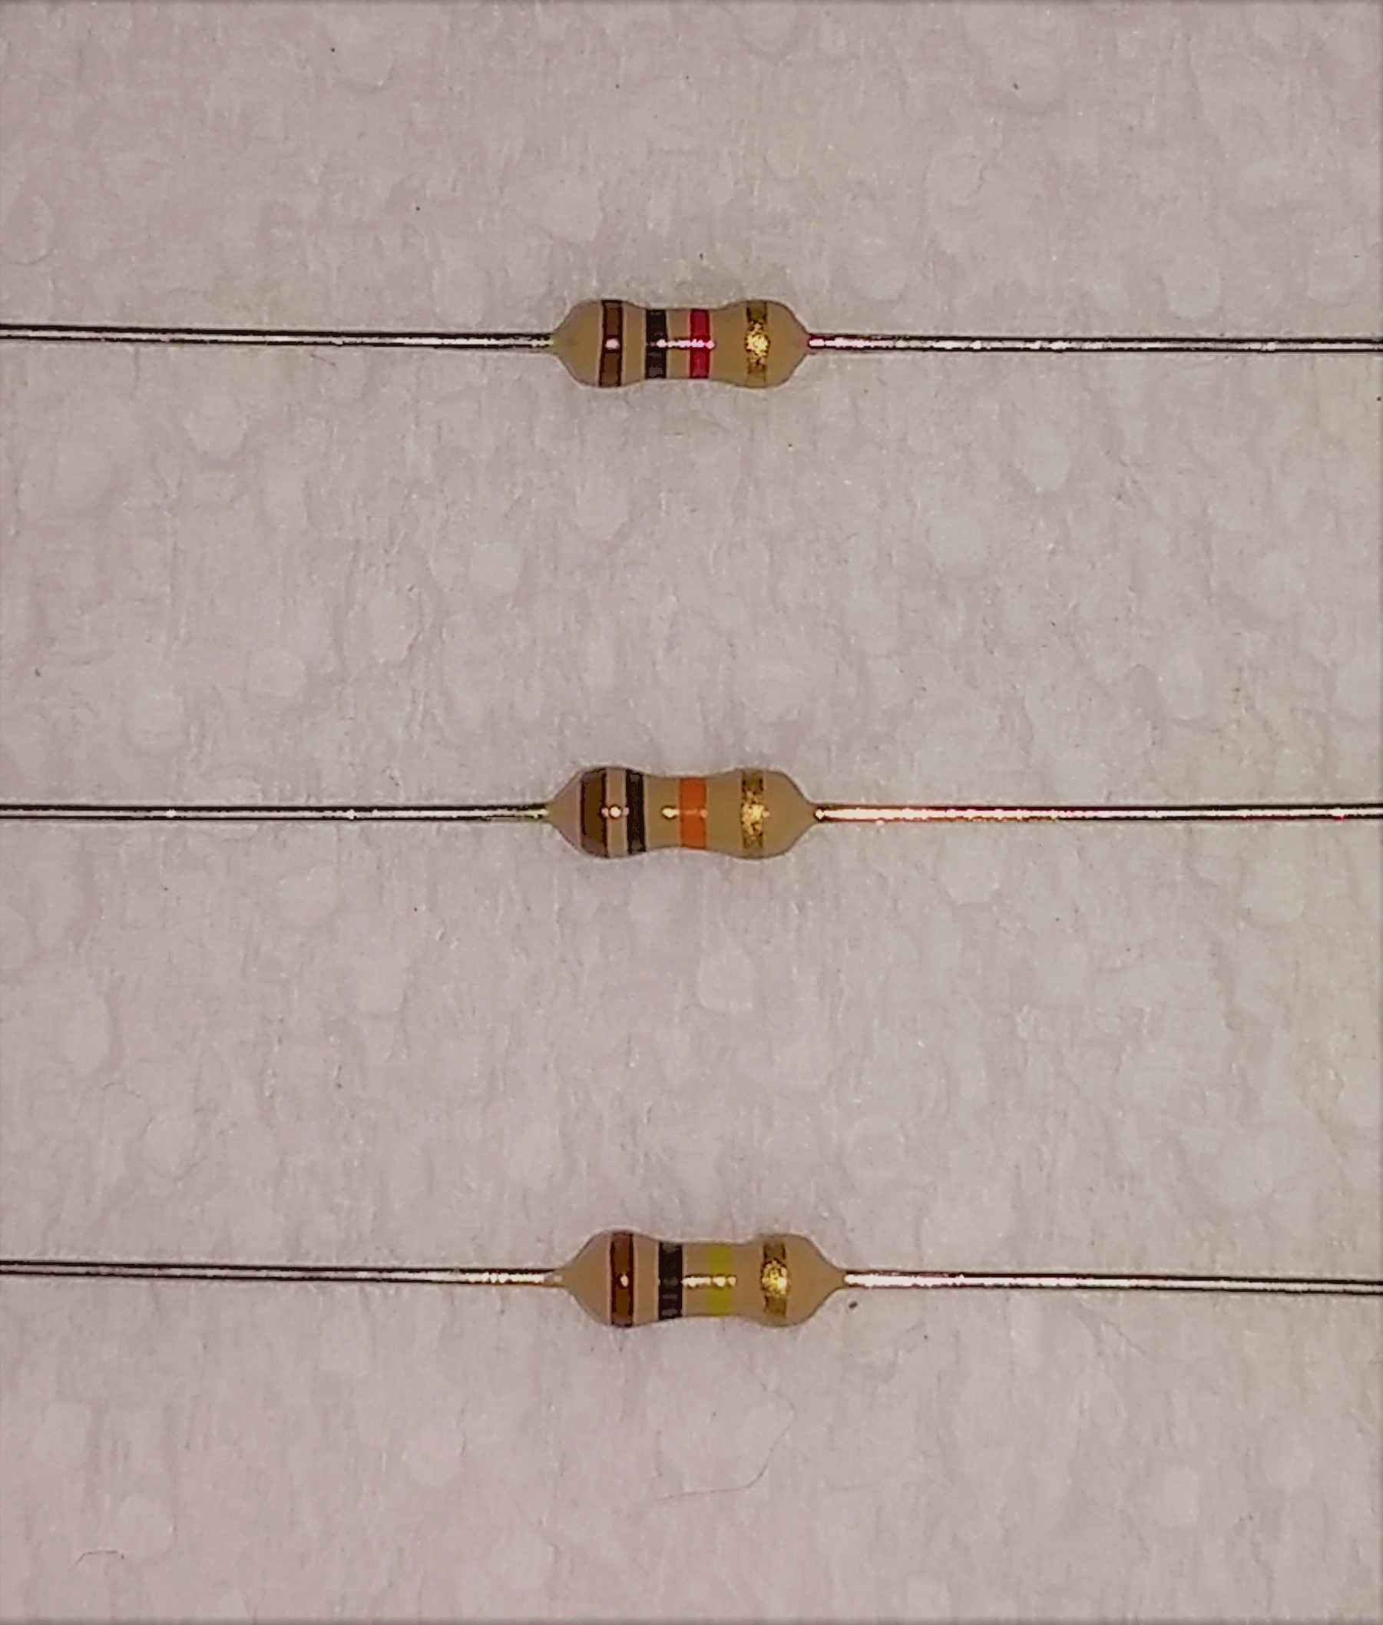
Resistors
1KΩ
Resistors are passive components that resist the flow of electrical current
Resistance is measured in ohms (Ω), named after Georg Ohm
Resistors are typically rated for a maximum power in watts (W), after James Watt
Colored bands indicate the characteristic resistance
10KΩ
100KΩ

Slide 7
Capacitors
A capacitor is a passive component that stores electrical energy
Capacitance is measured in farads, named after Michael Faraday
There are many kinds of capacitors with different properties
We will be using electrolytic capacitors in this class
Electrolytic capacitors are polarized
Capacitors have a rated working voltage

Slide 8
Switches
A switch is usually an electro-mechanical device that alternately conducts or does not conduct the flow of electric current
You can make a very simple switch by just touching two wires together
Some switches can control more than one circuit at a time
We will use a momentary push button switch in this class

Slide 9
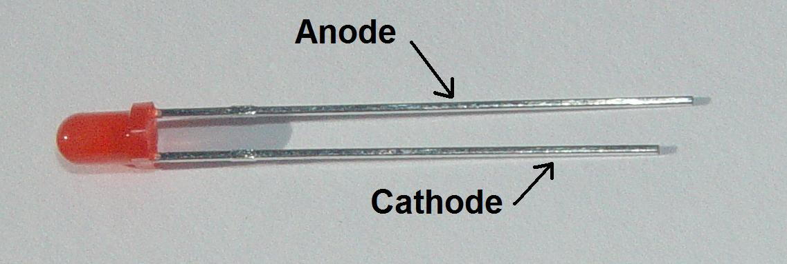
Light emitting diodes (LEDs)
An LED is a semiconductor device that emits light, sometimes visible
An LED must be used with a current-limiting resistor in most circuits
LEDs are polarized and will not work (as expected) if installed backwards
The anode is the positive lead
The cathode is the negative lead
The longer lead is the anode

Slide 10
Integrated circuits (ICs)
Integrated circuits, sometimes called chips, are a circuit of electronic components built on a single semiconductor die contained within a protective package
Jack Kilby of Texas Instruments won the Nobel Prize in 2000 for his work on ICs
ICs come in all sizes and shapes
The 555 chip we will be using is an example of an integrated circuit

Slide 11
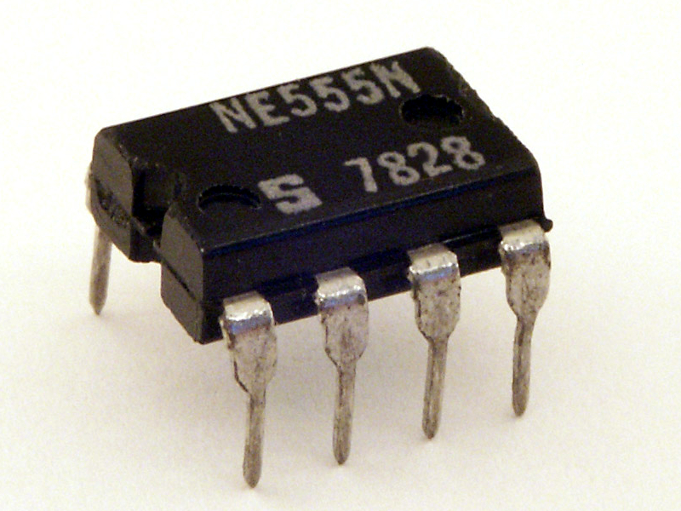
The NE555 / ICM7555 / TLC555 timer IC
The original “555” was Signetic’s NE555, designed by Hans R. Camenzind in 1971
https://en.wikipedia.org/wiki/File:Signetics_NE555N.JPG

Slide 12
How to read a schematic
Schematics are specialized diagrams showing components and connections between them
Schematics need not resemble the final circuit, as built
Schematics should contain enough information to build and test the circuit

Slide 13
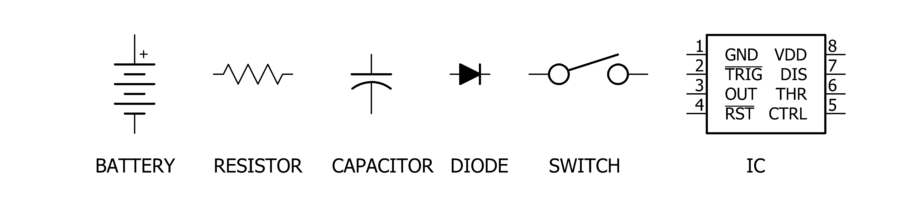
Schematic symbols

Slide 14
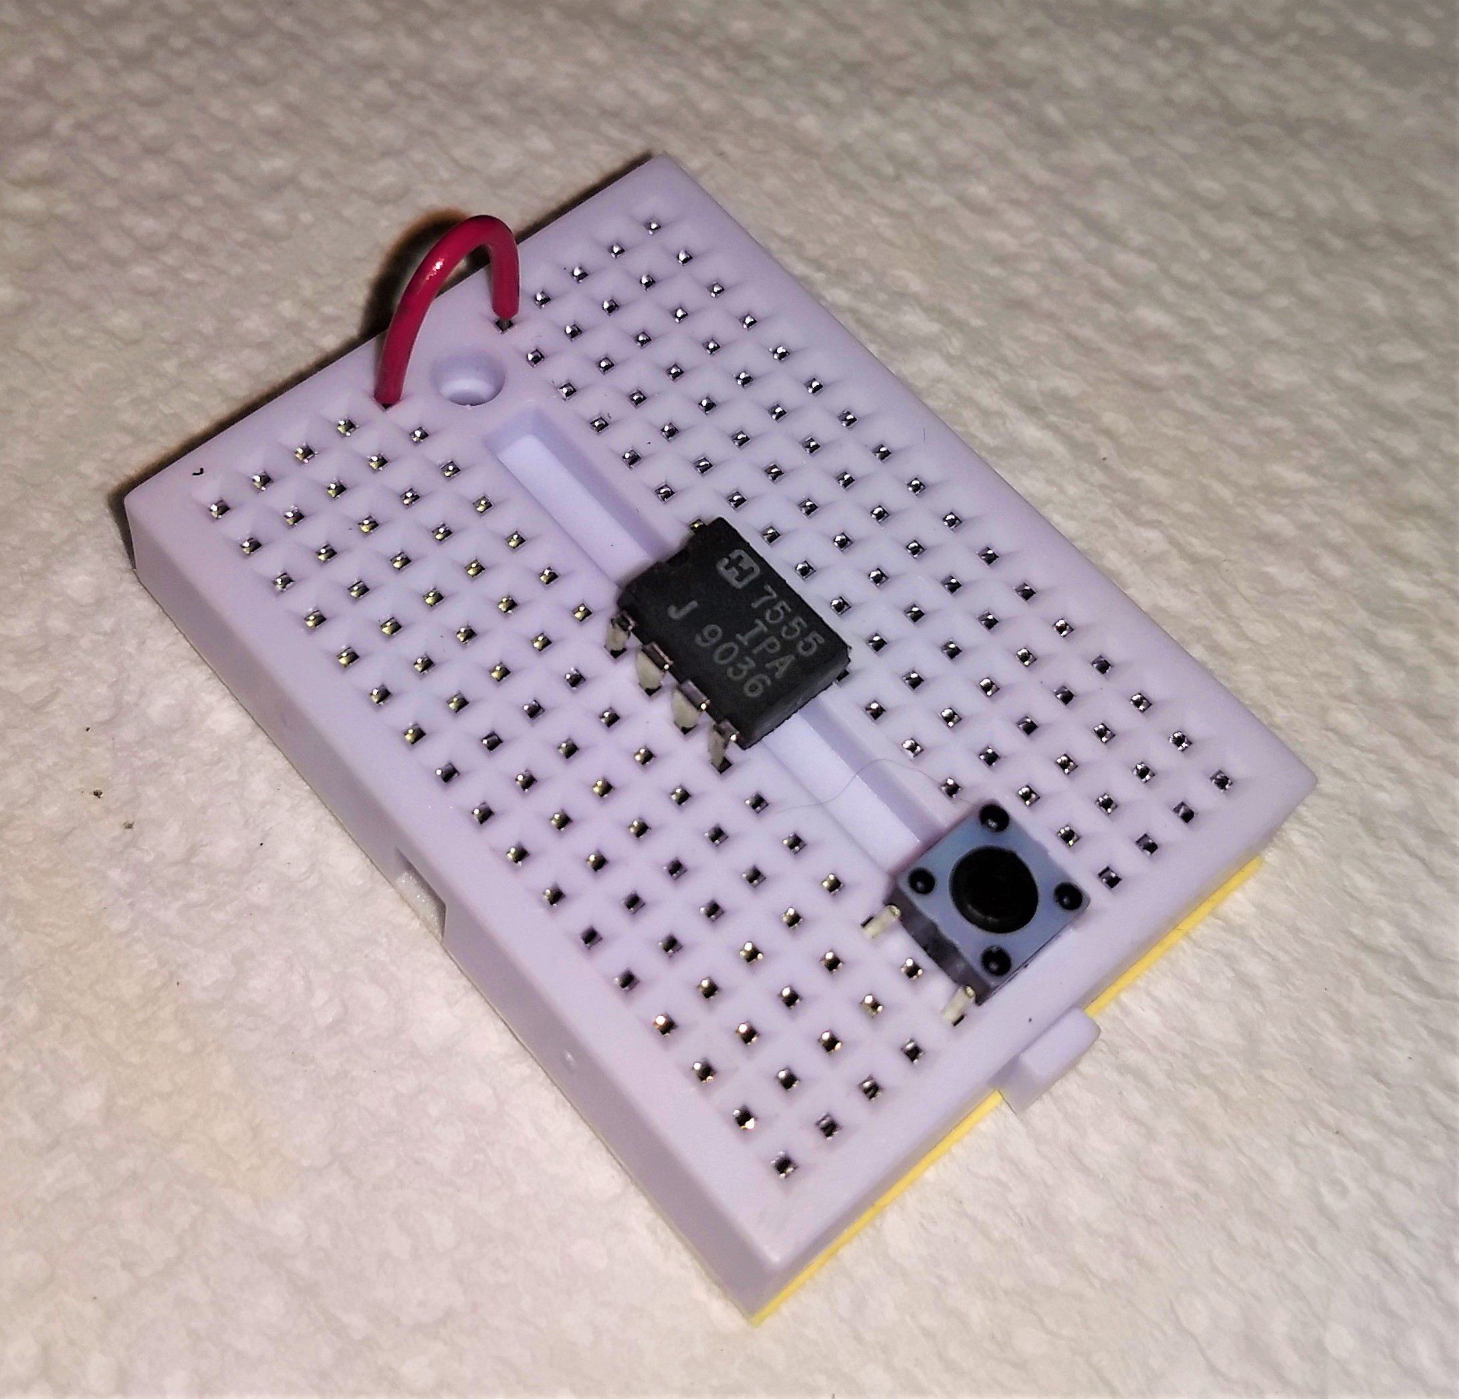
Building circuits on solderless breadboards
The solderless breadboard in your kit is a white, rectangular, plastic block
Spring clips hold the components in place
Each block of 5 pins is electrically connected
There should already be some parts installed
  The 555 chip
  A push button
  One red wire jumper

Slide 15
Procedural notes
Always disconnect the power from the circuit before adding or changing anything
Don’t modify the circuit while the power is on

Slide 16
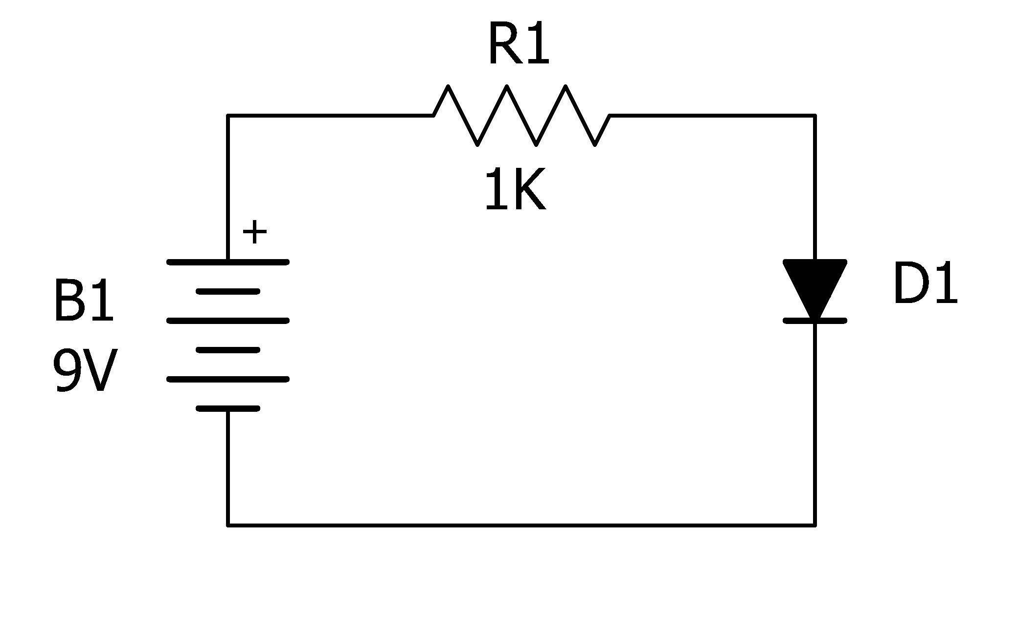
Circuit #1 - LED
For our first circuit, we’re going to light up an LED
Here is the schematic diagram for this circuit

Slide 17
Build the LED circuit
Choose either the red or green LED
Find a 1KΩ resistor (brown, black, red, gold stripes)
Bend the leads of the resistor into a large bow shape
Insert one end of the resistor in the top row of holes
Insert the other end of the resistor in the next-to-bottom row of holes

Slide 18
Build the LED circuit, continued
Connect the anode of the LED (longer lead) into the next-to-bottom row
Connect the cathode of the LED into the bottom row of pins
Attach the leads of the 9V battery snap
  The red lead (positive) goes in the top row
  The black lead (negative) goes in the bottom row

Slide 19
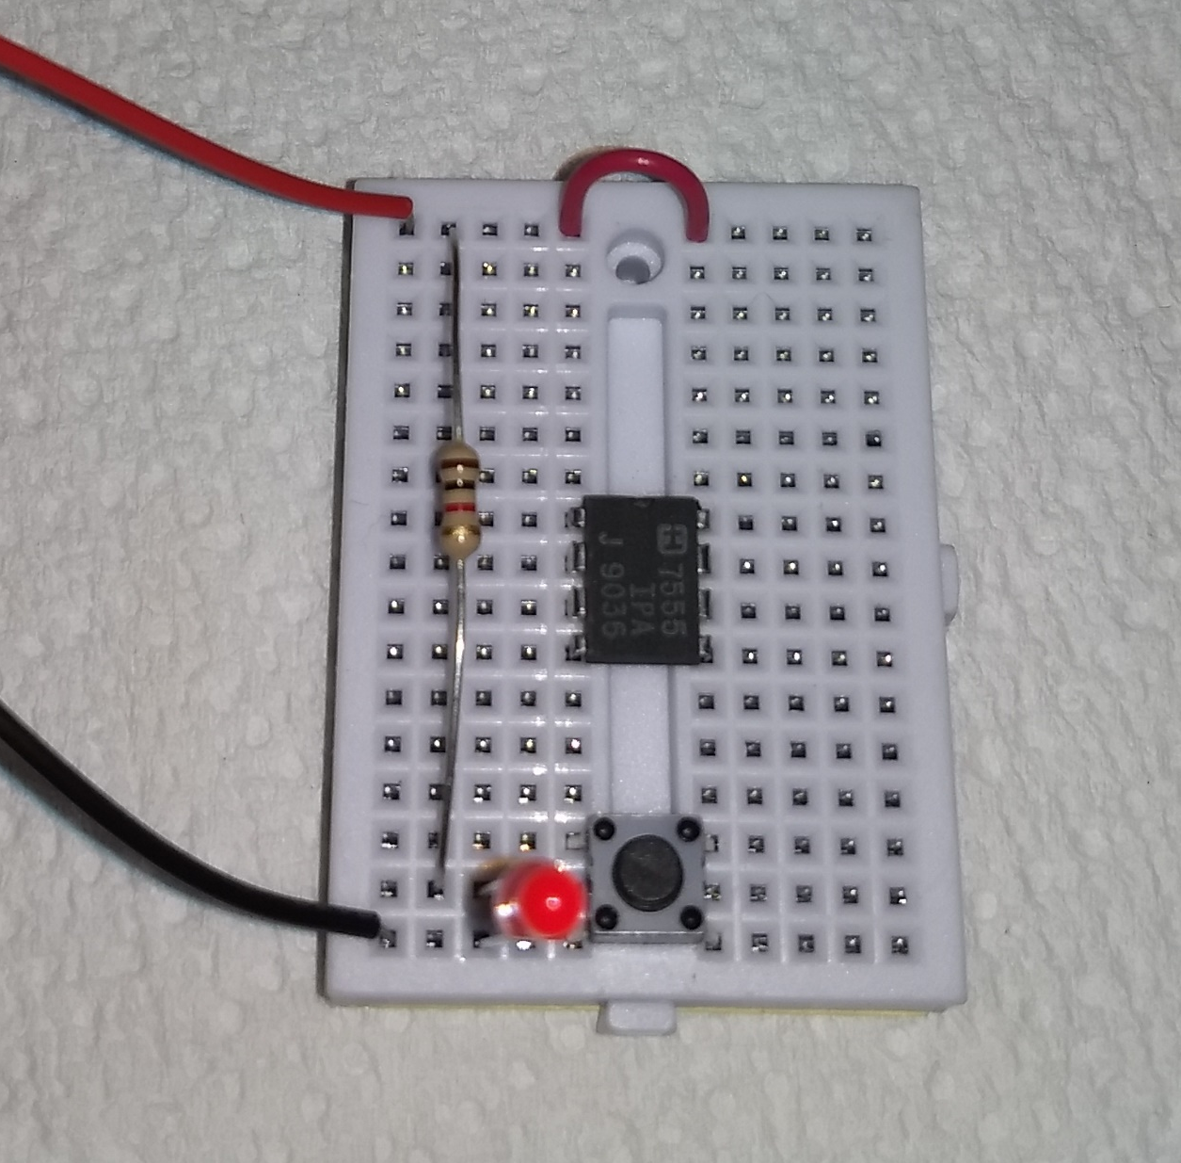
Circuit #1 – Check your work
Confirm your circuit looks reasonably close to the picture before proceeding

Slide 20
Circuit #1 – Ready to test
Connect the 9V battery to the battery snap
Behold!

Slide 21
Troubleshooting
Did your LED light up and shine merrily?
If yes, then proceed to the next circuit
If no, then let’s figure out what went wrong
Here is a list of some of the most probable issues
  Component selection
  Component placement
  LED polarity
  Wiring
  Depleted battery

Slide 22
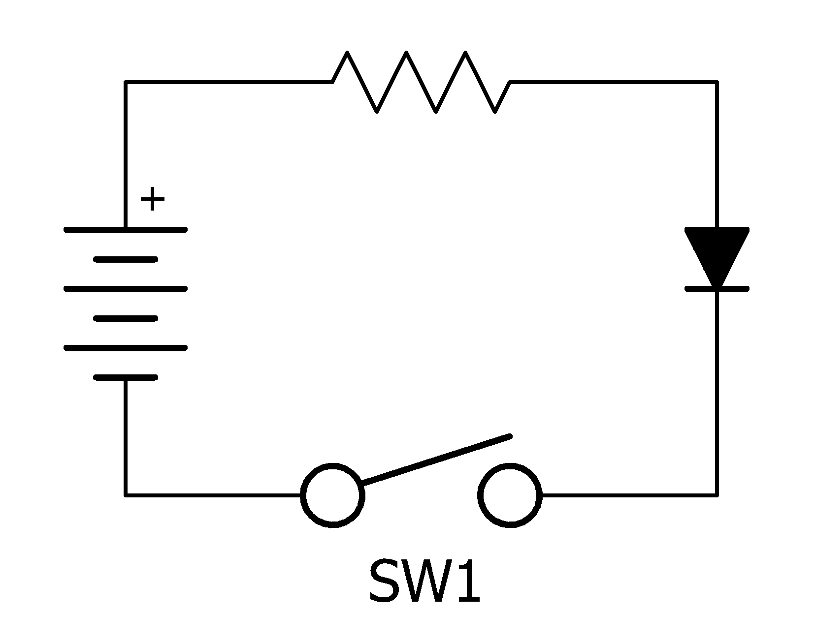
Circuit #2 – LED with switch
Let’s add a switch to the circuit
Here is the schematic diagram of the LED circuit with a switch added
We could have added the switch anywhere in the circuit and it would work the same way

Slide 23
Circuit #2 – LED with switch wiring
The switch should already be installed on your breadboard
Move the LED up two rows so the cathode is lined up with the top leads of the switch
Move the bottom lead of the resistor to the anode of the LED
Check your wiring

Slide 24
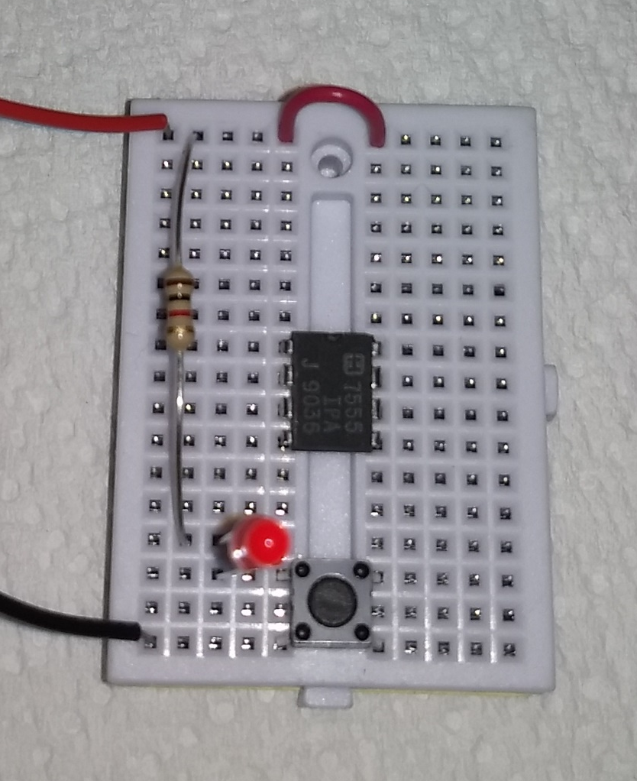
Circuit #2 – Check your wiring & test
Confirm your wiring looks like the picture
If you’re happy with the wiring, connect the battery
Push the button
Behold!

Slide 25
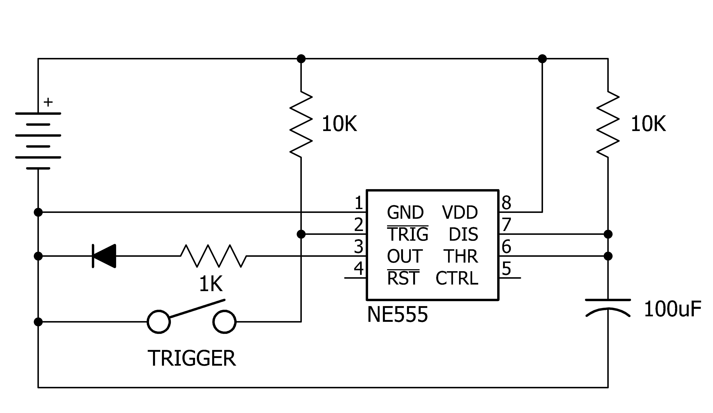
Circuit #3 – 555 one-shot timer
Now we’re going to build a more complex circuit called a “one shot” timer
Here is the schematic

Slide 26
Circuit #3 – Wiring procedure
Disconnect the battery
Remove the LED and the 1KΩ (brown, black, red) resistor
The 555 chip should already be installed on your breadboard
Connect a red jumper from the top right row to pin 8 of the IC (top right corner)
Connect a black jumper from pin 1 of the IC (top left pin) to the bottom row
Connect a 10KΩ resistor (brown, black, orange) from the top row to pin 7 of the IC
Connect a purple jumper between pins 7 and 6 of the IC

Slide 27
Circuit #3 – Wiring, continued
Find the larger of the two capacitors (100μF)
Connect the longer lead (anode) to pin 6 of the IC
Connect the cathode to the bottom row of holes
Choose a red or green LED
Install the LED with its cathode (shorted lead) in the bottom row of holes
Use a 1KΩ (brown, black, red) resistor to connect pin 3 of the IC to the anode of the LED
Use a green jumper wire to connect pin 2 of the IC to the top row of the switch
Connect a 10KΩ (brown, black, orange) resistor from the top row to pin 2 of the IC

Slide 28
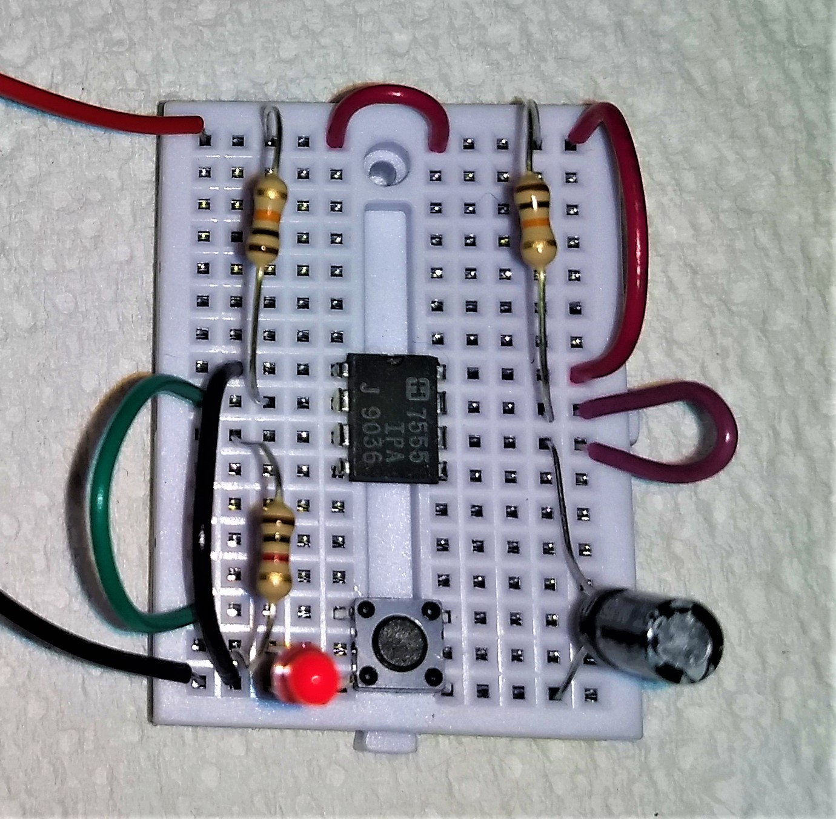
Circuit #3 – Check your work & test
Make sure your circuit looks like the picture
Connect the battery
Push the button
The LED should light for 1-2 seconds then go out again
Try changing the 10KΩ resistor to a 100KΩ resistor for a longer on-time

Slide 29
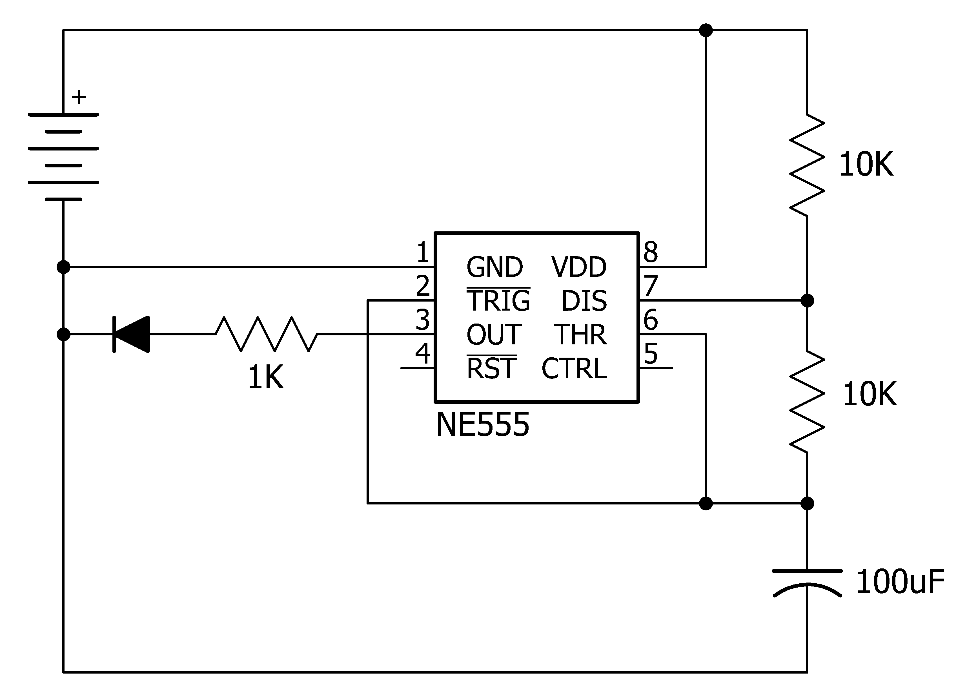
Circuit #4 – 555 oscillator
Instead of using a trigger switch, we can have the 555 trigger itself
This mode of operation is called a bistable multivibrator circuit
Here is a schematic

Slide 30
Circuit #4 - Wiring
Remove the 10KΩ (brown, black, orange) resistor from pin 2 of the IC
Replace the purple jumper wire with a 10KΩ (brown, black, orange) resistor
Move the green jumper wire to connect pin 2 of the IC to pin 6

Slide 31
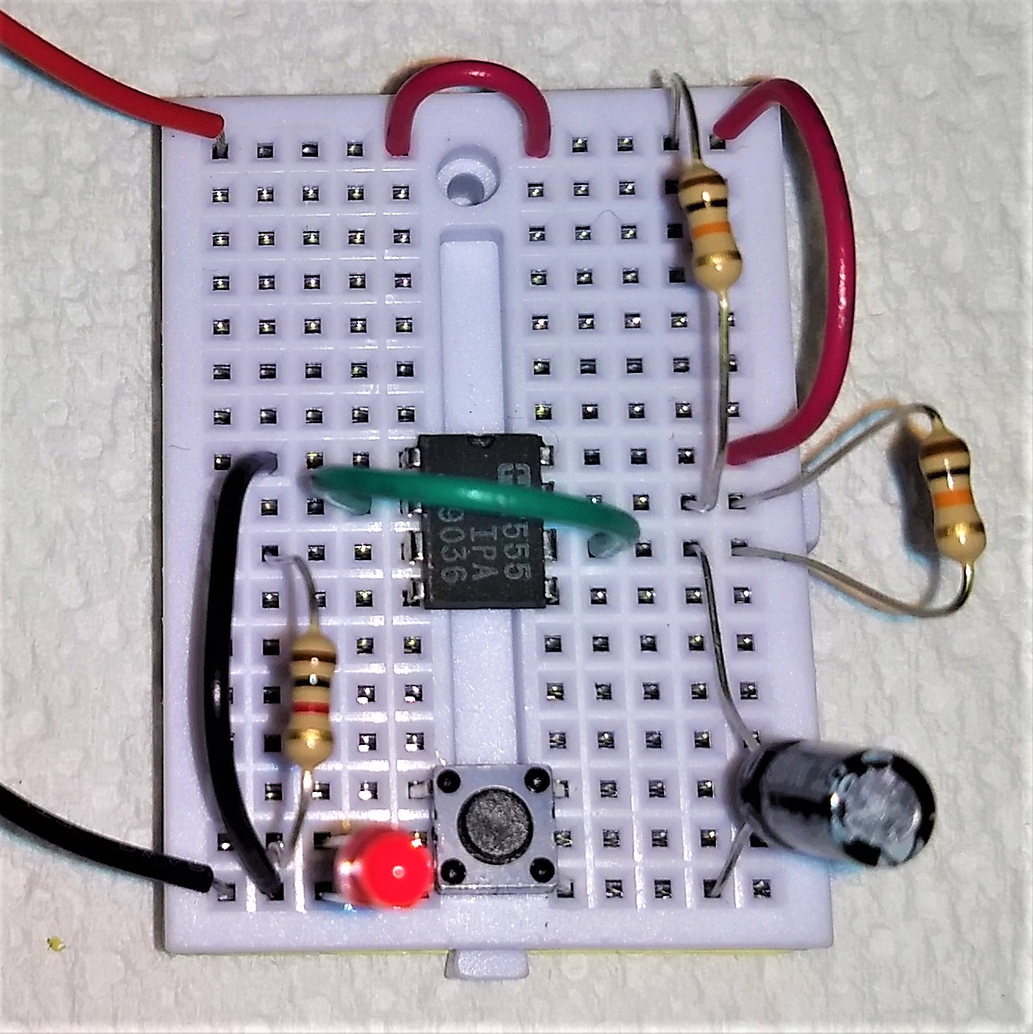
Circuit #4 – Check your work
Compare your circuit to the picture
Connect the battery
Does it blink?

Slide 32
Circuit #5 – Slower oscillator
Disconnect the battery
Remove the 10KΩ resistor (brown, black, orange) from the top right
Replace it with a 100KΩ resistor (brown, black, yellow)
Connect the battery
Verify a much slower blink cycle
Note that the one-time is much longer, but the off-time is about the same
Changing the lower resistor will change the off-time

Slide 33
Circuit #6 – Dual LED outputs
Since the 555 chip has a “push-pull” output, it can both source and sink current
We can use this feature to alternately blink two different LEDs
Disconnect the battery
Connect the anode (longer lead) of the other LED to the top row of holes
Use a 1KΩ resistor (brown, black, red) to connect the LED’s cathode to pin 3 of the IC
Connect the battery
Only one LED should be on at a time

Slide 34
Circuit #7 – Faster oscillator
Available in the Advanced 555 class!
Stay tuned!

Slide 35
Circuit #8 – Tone generator
Available in the Advanced 555 class!
Stay tuned!

Slide 36
Conclusion
Electricity likes to flow in a circle
It’s easy and fun to build electronic circuits on a solderless breadboard
The 555 is a versatile chip that can be used for many applications
There’s a lot more to learn!

Slide 37
Review
What did you learn?
Are you planning more electronic projects?
Did you enjoy this class?
Did this class meet your expectations?
Would you recommend this class to your friends?
What other classes would you like to take?

Slide 38

Thank you
Thank you for your participation

